Slide 1


Vidyalankar Institute of Technology
Department of Computer Engineering
Academic Year 2021-2022
Semester: VI
Faculty : Dr. Kavita P Shirsat
Course Code | Course Title | Credit
CSDL06013 | Quantitative Analysis | 3

Slide 2

Why we need Quantitative Analysis(quants)
Information Explosion
Noisy and huge amount of data
Traditional Models are broken
Quantitative analysis (QA)
QA is a technique uses mathematical and statistical modeling, measurement, and research to understand behavior

Slide 3
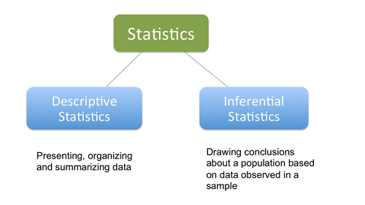
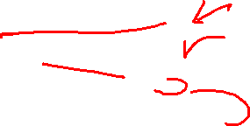
How does quantitative analysis work?
Statistical analysis methods
basic calculations (for example, averages and medians)
More sophisticated analyses (for example, correlations and regressions).
Functions of Statistics
Collection of data
Tabulation of data
Analysis of data
Interpretation of results

Slide 4
Course Code | Course Title | Credit
CSDL06013 | Quantitative Analysis | 3
Module | Content | Hrs
1 | Introduction to Statistics Functions – Importance – Uses and Limitations of Statistics. Statistical data–Classification, Tabulation, Diagrammatic & Graphic representation of data | 6
2 | Data Collection & Sampling Methods Primary & Secondary data, Sources of data, Methods of collecting data. Sampling – Census & Sample methods –Methods of sampling, Probability Sampling and Non-Probability Sampling. | 5
3 | Introduction to Regression Mathematical and Statistical Equation – Meaning of Intercept and Slope – Error term – Measure for Model Fit –R2 – MAE – MAPE | 8
4 | Introduction to Multiple Linear Regression Multiple Linear Regression Model, Partial Regression Coefficients, Testing Significance overall significance of Overall fit of the model, Testing for Individual Regression Coefficients | 8
5 | Statistical inference Random sample -Parametric point estimation unbiasedness and consistence - method of moments and method of maximum likelihood. | 6
6 | Tests of hypotheses Null and Alternative hypotheses. Types of errors. Neyman-Pearson lemma-MP and UMP tests. | 5
Textbooks:
1 | Agarwal, B.L. (2006):-Basic Statistics. Wiley Eastern Ltd., New Delhi
2 | Gupta, S. P. (2011):-Statistical Methods. Sultanchand&Sons, New Delhi
3 | Sivathanupillai, M &Rajagopal, K. R. (1979):-Statistics for Economics Students.
4 | Hogg ,R.V. and Craig, A.T.(2006), An introduction to mathematical statistics, Amerind publications.
5 | Gupta S.C. and Kapoor V.K.(2003), Funadmental of Mathematical Statistics, Sultan Chand & company, New Delhi

Slide 5
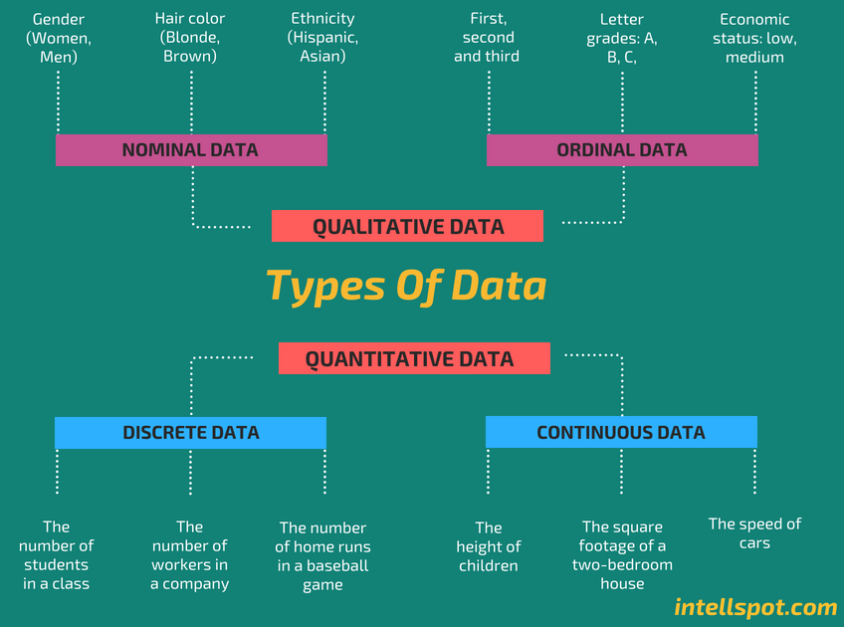
What is Data?
Definition: Facts or figures, which are numerical or otherwise, collected with a definite purpose are called data.

Slide 6
Qualitative and Quantitative Data
Qualitative Data: They represent some characteristics or attributes. They depict descriptions that may be observed but cannot be computed or calculated.
For example, data on attributes such as intelligence, honesty, wisdom, cleanliness, and creativity collected using the students of your class.
Quantitative Data: These can be measured and not simply observed. They can be numerically represented and calculations can be performed on them.
For example, data on the number of students playing different sports from your class gives an estimate of how many of the total students play which sport.

Slide 7
Nominal and Ordinal Data
Nominal data
Nominal data is used just for labeling variables, without any type of quantitative value.
Examples of Nominal Data:
Gender (Women, Men)
Hair color (Blonde, Brown, Brunette, Red, etc.)
Marital status (Married, Single, Widowed)
Ordinal data
Ordinal data shows where a number is in order.
Ordinal data is data which is placed into some kind of order by their position on a scale. Ordinal data may indicate superiority.
We cannot do arithmetic with ordinal numbers because they only show sequence.
Examples of Ordinal Data:
When a company asks a customer to rate the sales experience on a scale of 1-10.
Economic status: low, medium and high.

Slide 8
Discrete vs Continuous Data
Discrete data
Discrete data is a count that involves only integers. The discrete values cannot be subdivided into parts.
Examples of discrete data:
The number of students in a class.
The number of workers in a company.
The number of test questions you answered correctly
Continuous data
Continuous data is information that could be meaningfully divided into finer levels. It can be measured on a scale or continuum and can have almost any numeric value.
Examples of continuous data:
The amount of time required to complete a project.
The height of children.
The square footage of a two-bedroom house.

Slide 9
Classification of Data
The placement of data in different homogenous groups based on some characteristics or criteria is called classification.
The classified data is presented in the form of well-arranged Tables.
Systematics arrangement of data in rows and/or columns is called as Tables
Some norms for ideal classification and tabulation are
The classes should be complete and non-overlapping
Ex classify people according to marital status
Clarity of classes
Use standardized of classes so that comparison of results on time to time becomes easy
The units of the class should be same.

Slide 10
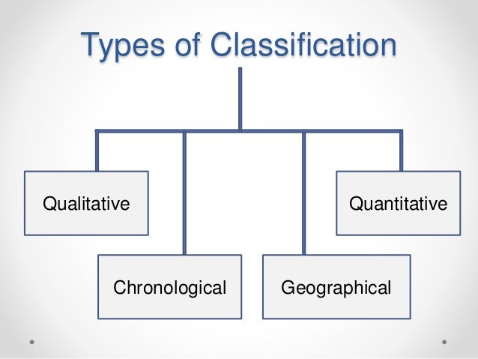
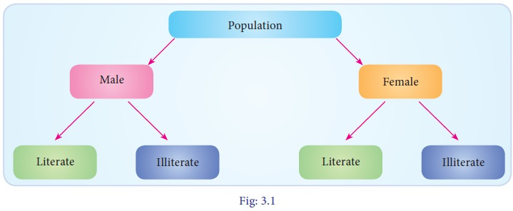
Modes of Classification
Classification according to Attributes or Qualitative classification.
Dichotomy or Two-fold Classification:- When on the basis of presence or absence of an attribute, the data are classified into two classes--- one possessing that attribute, and the other not possessing that attribute, it is called two-fold or dichotomous classification.
Population
with color blindness without color blindness
Manifold Classification:- The classification, where two or more attributes are considered and several classes are formed, is called manifold classification. First of all universe/population is divided onto two classes on the basis of one attribute, after that each class is further divided into two sub-classes on the basis of second attribute. If third attribute is also to be considered, each sub-class is further classified into two sub-classes.

Slide 11
Modes of Classification
Classification according to variables or Quantitative classification
Geographical classification
When data are classified on the basis of location or areas, it is called geographical classification.
This type of classification is based on geographical or locational differences between various items in the data like states, cities, regions, zones etc. For eg. The yield of agricultural output per hectare for different countries in some given period may be presented as follows:
Agricultural Output of different countries (in Kg. per hectare)
Country | India | USA | Pakistan | Japan | china
Avg. Output | 125 | 585 | 140 | 410 | 330

Slide 12
Modes of Classification
chronological classification.
When data are classified with respect to different periods of time ( hour, day, week, month, year, etc.) it is known as chronological or temporal classification. For example, the population of India for different decades may be presented as folows:
Population of India ( in Crores)
Year | 1951 | 1961 | 1971 | 1981 | 1991 | 2000
Population | 36.1 | 43.9 | 54.7 | 68.5 | 84.4 | 102.7

Slide 13
Quantitative classification
In this type of classification there are two elements
variable
Variable refers to the characteristic that varies in magnitude or quantity. E.g. weight of the students. A variable may be discrete or continuous.
Frequency
Frequency refers to the number of times each variable gets repeated. For example there are 50 students having weight of 60 kgs. Here 50 students is the frequency.

Slide 14
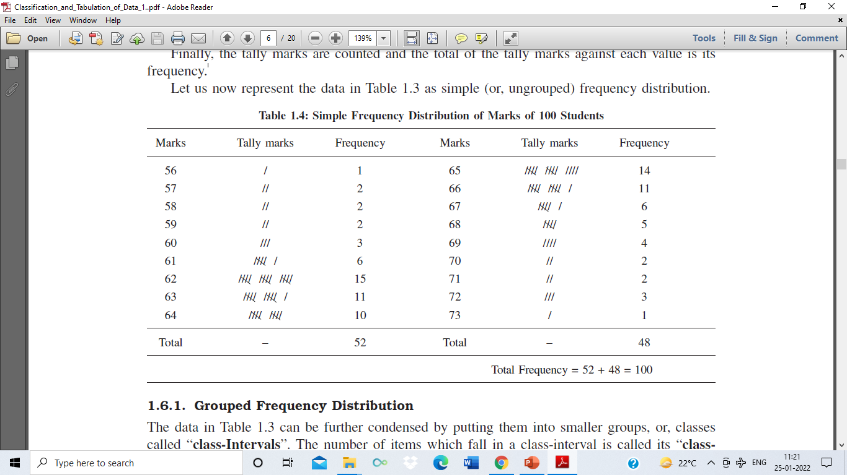
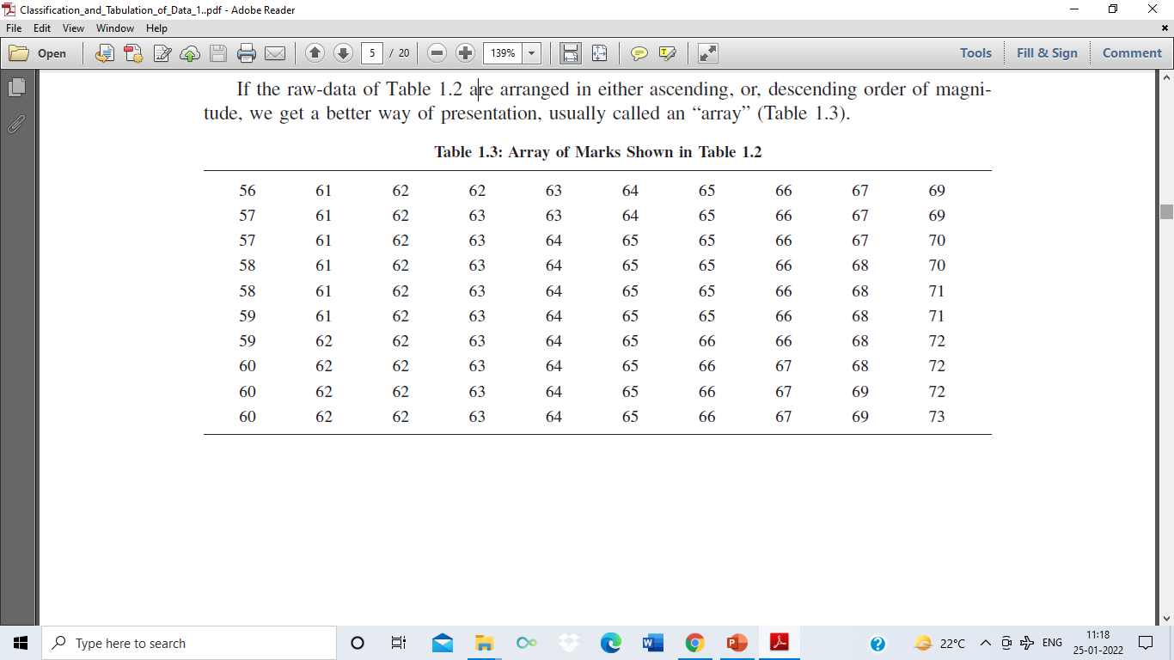
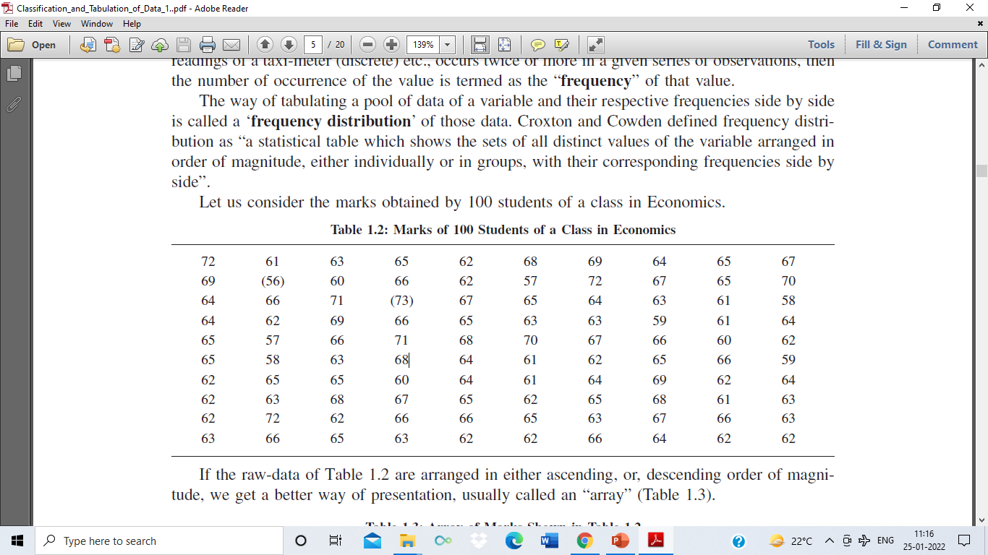
Frequency distribution
The number of occurrence of the value is termed as the “frequency” of that value.
Frequency distribution refers to data classified on the basis of some variable that can be measured such as prices, weight, height, wages etc.

Slide 15
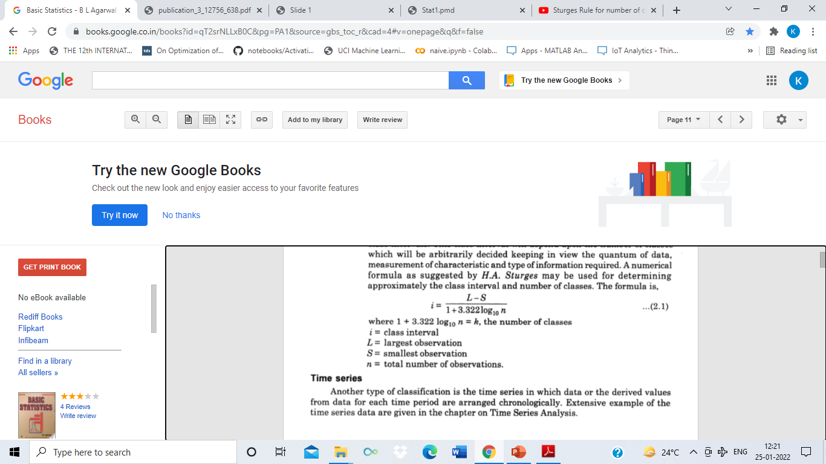
Frequency distribution
Grouped Frequency Distribution
The tabulation of raw data by dividing the whole range of observations into a number of classes and indicating the corresponding class-frequencies against the class-intervals, is called “grouped frequency distribution”.
Data can be further condensed by putting them into smaller groups, or, classes called “class-Intervals”. The number of items which fall in a class-interval is called its “class frequency”
Sturges Rule for number of classes and size of interval

Slide 16

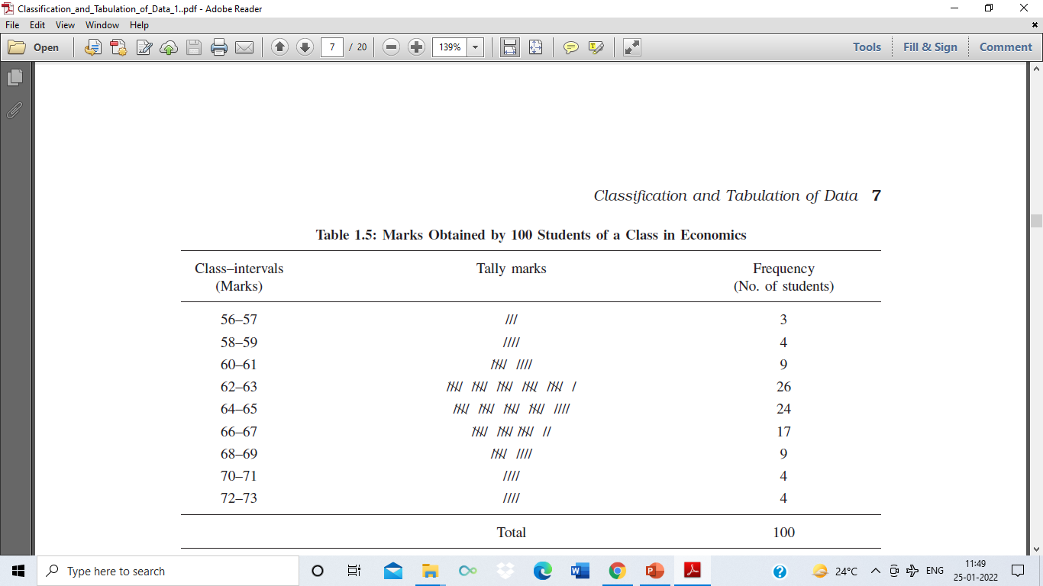
Frequency distribution
Grouped Frequency Distribution

Slide 17
Frequency distribution
The following technical terms are important when a continuous frequency distribution is formed
Class limits: Class limits are the lowest and highest values that can be included in a class. For example take the class 51-55. The lowest value of the class is 51 and the highest value is 55. In this class there can be no value lesser than 51 or more than 55. 51 is the lower class limit and 55 is the upper class limit.
Class interval: The difference between the upper and lower limit of a class is known as class interval of that class.
Class frequency: The number of observations corresponding to a particular class is known as the frequency of that class.
Two types according to the class-intervals - (i) Exclusive Method (ii) Inclusive Method.

Slide 18
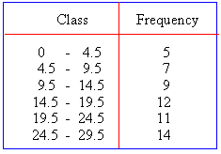
Exclusive Method
Exclusive Method : In this method the upper limit of a class becomes the lower limit of the next class. It is called ' Exclusive ' as we do not put any item that is equal to the upper limit of a class in the same class; we put it in the next class.
For example, a person of age 20 years will not be included in the class-interval ( 10 - 20 ) but taken in the next class ( 20 - 30 ), since in the class interval ( 10 - 20 ) only units ranging from 10 - 19 are included. The exclusive-types of class-intervals can also be expressed as
0 and below 4.5 or 0 – 4.4
4.5 and below 9.5 or 4.5 – 9.4
9.5 and below 14.5 or 9.5- 14.4 .

Slide 19
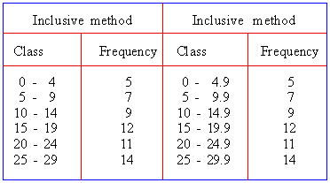
Inclusive Method
Inclusive Method : In this method the upper limit of any class interval is kept in the same class-interval. In this method the upper limit of a previous class is less by 1 from the lower limit of the next class interval. In short this method allows a class-interval to include both its lower and upper limits within it.

Slide 20
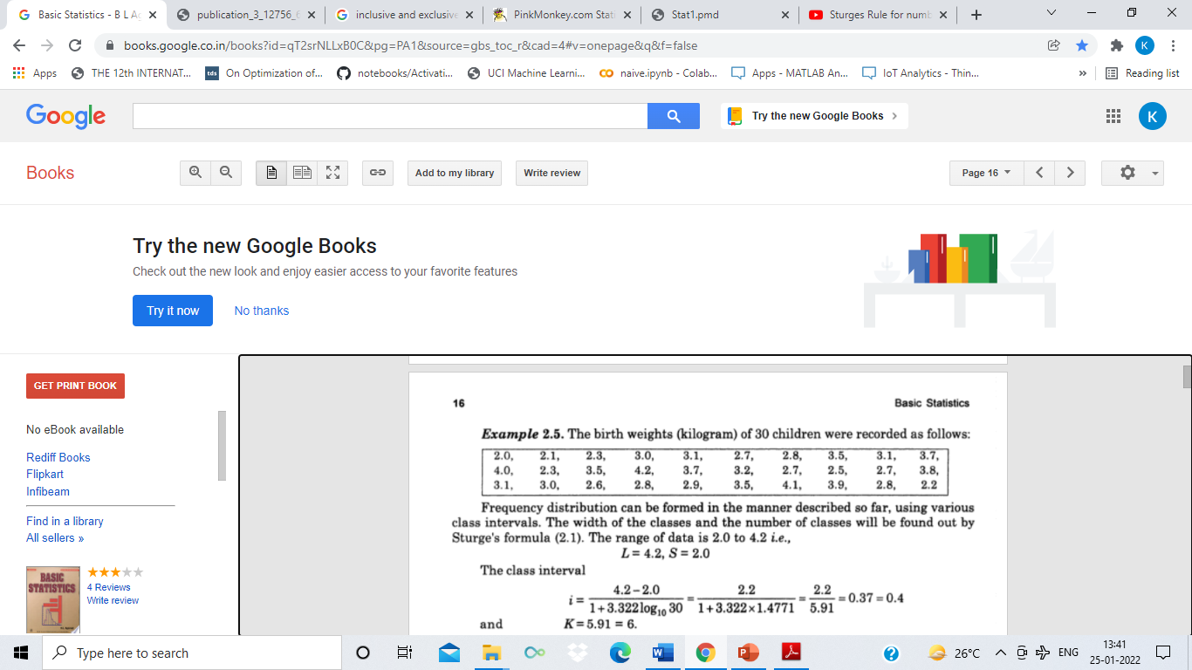

Example
Classes | Tally marks | No of children (frequency)
2.0-2.4 | |||| | 5
2.4-2.8 | |||| | 5
2.8-3.2 | |||| |||| | 9
3.2-3.6 | |||| | 4
3.6-4.0 | |||| | 4
4.0-4.4 | ||| | 3

Slide 21

Example
Classes | Tally marks
2.0-2.4
2.4-2.8
2.8-3.2
3.2-3.6
3.6-4.0
4.0-4.4

Slide 22
CUMULATIVE FREQUENCY DISTRIBUTION
Cumulative frequency of a class-interval can be obtained by adding the frequency of that class-interval to the sum of the frequencies of the preceding class-intervals.
There are two types of cumulative frequencies
(1) less than (or, from below) cumulative frequency, and
(2) more than (or, from above) cumulative frequencies.
Classes | Frequency | Less than type | Cumulative Frequency | More than type | Cumulative Frequency
30-40 | 2 | Less than 40 |  | More than 30
40-50 | 3 | Less than 50 |  | More than 40
50-60 | 5 | Less than 60 |  | More than 50
60-70 | 7 | Less than 70 |  | More than 60
70-80 | 6 | Less than 80 |  | More than70
80-90 | 2 | Less than 90 |  | More than 80
Total | 25

Slide 23
CUMULATIVE FREQUENCY DISTRIBUTION
Cumulative frequency of a class-interval can be obtained by adding the frequency of that class-interval to the sum of the frequencies of the preceding class-intervals.
There are two types of cumulative frequencies
(1) less than (or, from below) cumulative frequency, and
(2) more than (or, from above) cumulative frequencies.
Distribution of home prices (1 unit is Lakh).
Classes | Frequency | Less than type | Cumulative Frequency | More than type | Cumulative Frequency
30-40 | 2 | Less than 40 | 2 | More than 30 | 25
40-50 | 3 | Less than 50 | 5 | More than 40 | 23
50-60 | 5 | Less than 60 | 10 | More than 50 | 20
60-70 | 7 | Less than 70 | 17 | More than 60 | 15
70-80 | 6 | Less than 80 | 23 | More than70 | 8
80-90 | 2 | Less than 90 | 25 | More than 80 | 2
Total | 25

Slide 24
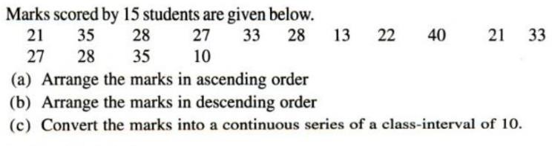

Slide 25
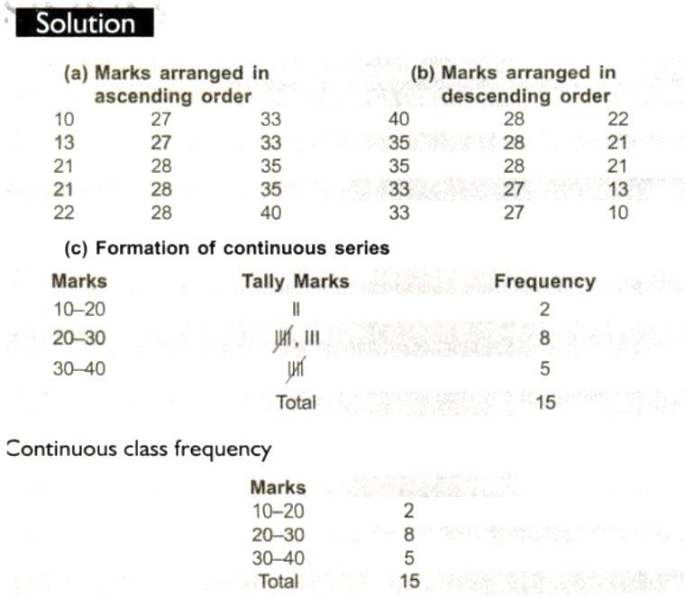

Slide 26
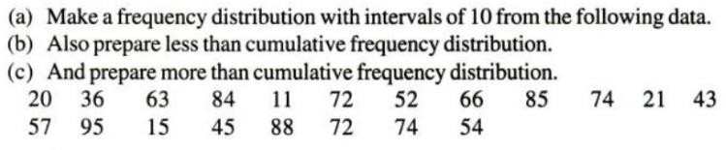

Slide 27
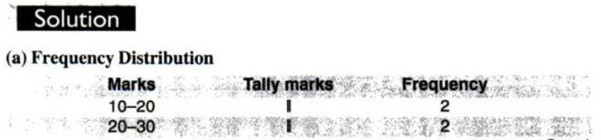
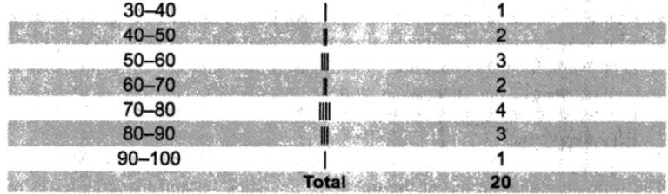

Slide 28
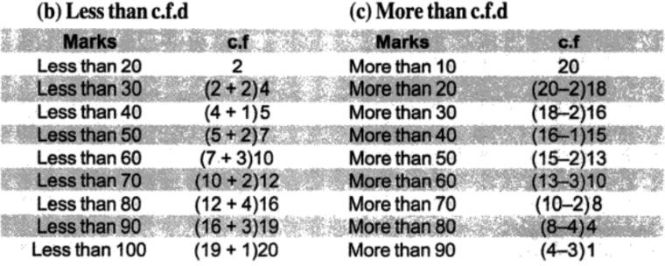

Slide 29

Relative frequency
A relative frequency distribution consists of the relative frequencies, or proportions (percentages), of observations belonging to each category.
Relative frequencies have a useful interpretation: They give the chance or probability of getting an observation from each category in a blind or random draw.
Classes | Frequency | Relative Frequency in percentage
30-40 | 2
40-50 | 3
50-60 | 5
60-70 | 7
70-80 | 6
80-90 | 2
Total | 25 | 100

Slide 30
Relative frequency
A relative frequency distribution consists of the relative frequencies, or proportions (percentages), of observations belonging to each category.
Relative frequencies have a useful interpretation: They give the chance or probability of getting an observation from each category in a blind or random draw.
Distribution of home prices (1 unit is Lakh).
Classes | Frequency | Relative Frequency in percentage
30-40 | 2 | 8
40-50 | 3 | 12
50-60 | 5 | 20
60-70 | 7 | 28
70-80 | 6 | 24
80-90 | 2 | 8
Total | 25 | 100

Slide 31
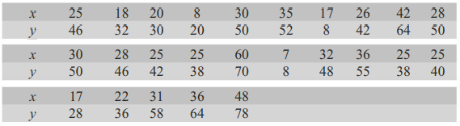
Two-way Frequency Distribution (Bivariate)
A frequency table where two variables have been measured in the same set of items through cross classification is known as bivariate frequency distribution or two-way frequency distribution.
For example, marks obtained by students on two subjects, ages of husbands and wives, weights and heights of students etc.
The following data represent the marks in
Statistics (x) and Commerce (y) of 25 students.
Bivariate Frequency Distribution
X → | 5-15 | 15-25 | 25-35 | 35-45 | 45-55 | 55-65 | Total
y↓
7-19
19-31
31-43
43-55
55-67
67-79
Total
78-7/1+3.322*log 25
i=10.69 and K=6.6

Slide 32
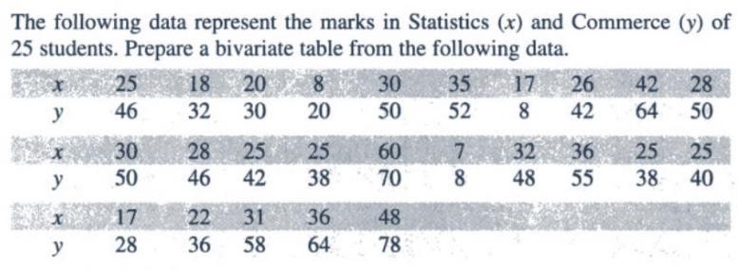

Slide 33
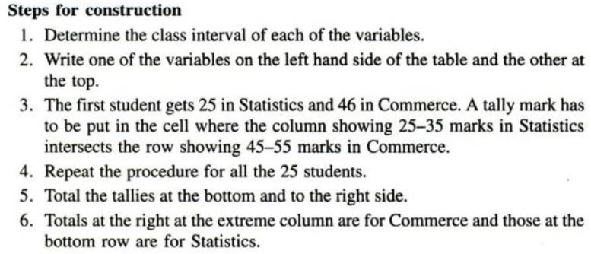

Slide 34
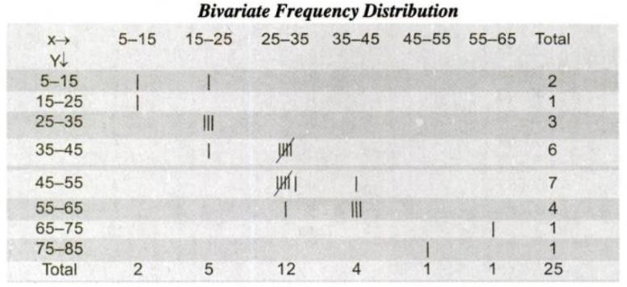

Slide 35
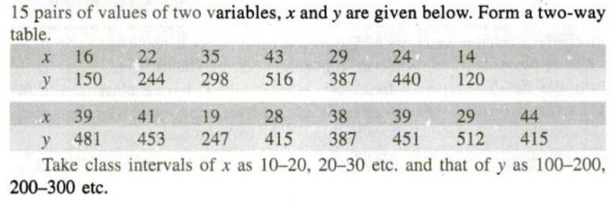

Slide 36
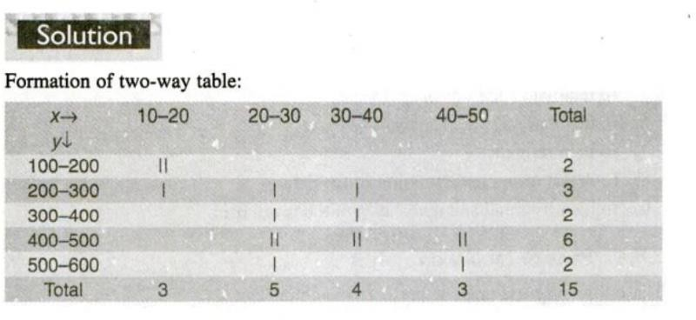

Slide 37
PRESENTATION OF STATISTICAL DATA
Statistical data can be presented in three different ways:
Textual presentation
Tabular presentation, and
Graphical presentation.

Slide 38
Textual presentation
Textual presentation: This is a descriptive form.
Example
Presentation of data about deaths from industrial diseases in Great Britain in 1935–39 and 1940–44.
Example . Numerical data with regard to industrial diseases and deaths thereform in Great Britain during the years 1935–39 and 1940–44 are given in a descriptive form: “During the quinquennium 1935–39, there were in Great Britain 1, 775 cases of industrial diseases made up of 677 cases of lead poisoning, 111 of other poisoning, 144 of anthrax, and 843 of gassing. The number of deaths reported was 20 p.c. of the cases for all the four diseases taken together, that for lead poisoning was 135, for other poisoning 25 and that for anthrax was 30. During the next quinquennium, 1940–44, the total number of cases reported was 2, 807. But lead poisoning cases reported fell by 351 and anthrax cases by 35. Other poisoning cases increased by 784 between the two periods. The number of deaths reported decreased by 45 for lead poisoning, but decreased only by 2 for anthrax from the pre-war to the post-war quinquennium. In the later period, 52 deaths were reported for poisoning other than lead poisoning. The total number of deaths reported in 1940–44 including those from gassing was 64 greater than in 1935–39”

Slide 39
Textual presentation
The disadvantages of textual presentation are:
it is too lengthy
there is repetition of words;
comparisons cannot be made easily;
it is difficult to get an idea and take appropriate action.

Slide 40
Tabular presentation, or, Tabulation
Tabulation may be defined as the systematic presentation of numerical data in rows or/and columns according to certain characteristics.
It expresses the data in concise and attractive form which can be easily understood and used to compare numerical figures.
Objectives of Tabulation
The main objectives of tabulation are stated below:
to carry out investigation;
to do comparison;
to locate omissions and errors in the data;
to use space economically;
to study the trend;
to simplify data;
to use it as future reference.

Slide 41
Tabular presentation, or, Tabulation
An ideal statistical table should contain the following items:
(i) Table number
(ii) Title
(iii) Date
(iv) Stubs, or, Row designations:
(v) Column headings, or, Captions
(vi) Body of the table
(vii) Unit of measurement
(viii) Source
(ix) Footnotes and references

Slide 42
Tabular presentation, or, Tabulation
An ideal statistical table should contain the following items:
(i) Table number: A number must be allotted to the table for identification, particularly when there are many tables in a study.
(ii) Title: The title should explain what is contained in the table. It should be clear, brief and set in bold type on top of the table. It should also indicate the time and place to which the data refer.
(iii) Date: The date of preparation of the table should be given.
(iv) Stubs, or, Row designations: Each row of the table should be given a brief heading. Such designations of rows are called “stubs”, or, “stub items” and the entire column is called “stub column”.
(v) Column headings, or, Captions: Column designation is given on top of each column to explain to what the figures in the column refer. It should be clear and precise. This is called a “caption”, or, “heading”. Columns should be numbered if there are four, or, more columns.
(vi) Body of the table: The data should be arranged in such a way that any figure can be located easily.
(vii) Unit of measurement: If the unit of measurement is uniform throughout the table, it is stated at the top right-hand corner of the table along with the title.
(viii) Source: At the bottom of the table a note should be added indicating the primary and
secondary sources from which data have been collected.
(ix) Footnotes and references: If any item has not been explained properly, a separate explanatory
note should be added at the bottom of the table.

Slide 43
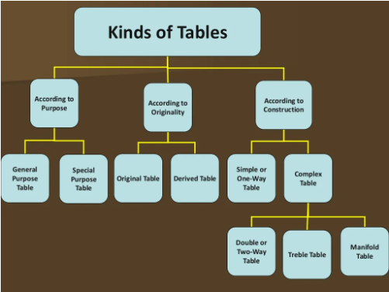
Kinds of Table
I. According to Purpose
General Purpose Table: General purpose table is that table which is of general use. It is does not serve any specific purpose or specific problem under consideration.
Special Purpose Table: Special Purpose table is that table which is prepared with some specific purpose in mind.
II. According to Originality
Original Table: An original table is that in which data are presented in the same form and manner in which they are collected.
Derived Table: A derived table is that in which data are not presented in the form or manner in which these are collected. Instead the data are first converted into ratios or percentage and then presented.

Slide 44
Kinds of Table
III. According to Construction
Simple Table :In a simple table (also known as one-way table), data are presented based on only one characteristic.
Complex Tables : In a complex table (also known as a manifold table) data are presented according to two or more characteristics simultaneously. The complex tables are two-way or three-way tables according to whether two or three characteristics are presented simultaneously.
Double or Two-Way Table
Three-Way Table
Manifold (or Higher Order) Table
Table 3.8 Marks of Students |  | Table 3.8
Marks | 30-40 | 40-50 | 50-60 | 60-70 | 70-80
Number of Students | 14 | 26 | 30 | 20 | 10

Slide 45
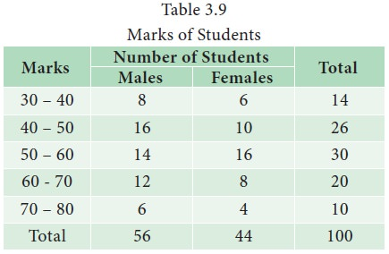
Kinds of Table
a. Double or Two-Way Table : In such a table, the variable under study is further subdivided into two groups according to two inter-related characteristics. The two-way table is shown in Table 3.9
There are two characteristics, namely, marks secured by the students in the test and the gender of the students. The table provides information relating to two interrelated characteristics, such as marks and gender of students.

Slide 46
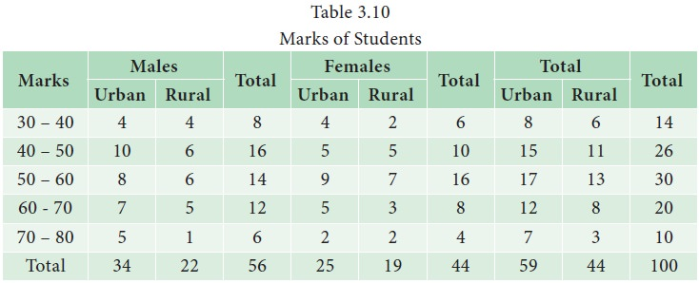
Kinds of Table
b. Three-Way Table : In such a table, the variable under study is divided according to three interrelated characteristics. The Three- Way Table is shown Table 3.10 is an example for a three – way table with three factors, namely, marks, gender and location.

Slide 47
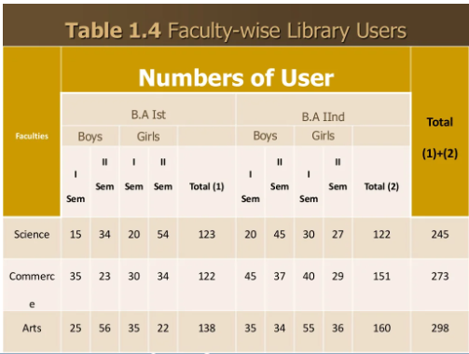
Kinds of Table
c) Manifold (or Higher Order) Table : In such a tables provide information about a large no of interrelated characteristics in the data set. Manifold (or Higher Order) Table is shown in Table 1.4.

Slide 48
Tabular presentation, or, Tabulation
Example . Numerical data with regard to industrial diseases and deaths thereform in Great Britain during the years 1935–39 and 1940–44 are given in a descriptive form: “During the quinquennium 1935–39, there were in Great Britain 1, 775 cases of industrial diseases made up of 677 cases of lead poisoning, 111 of other poisoning, 144 of anthrax, and 843 of gassing. The number of deaths reported was 20 p.c. of the cases for all the four diseases taken together, that for lead poisoning was 135, for other poisoning 25 and that for anthrax was 30. During the next quinquennium, 1940–44, the total number of cases reported was 2, 807. But lead poisoning cases reported fell by 351 and anthrax cases by 35. Other poisoning cases increased by 784 between the two periods. The number of deaths reported decreased by 45 for lead poisoning, but decreased only by 2 for anthrax from the pre-war to the post-war quinquennium. In the later period, 52 deaths were reported for poisoning other than lead poisoning. The total number of deaths reported in 1940–44 including those from gassing was 64 greater than in 1935–39”
Table 1.1 deaths form industrial diseases in Great Britain Date:
 | 1935-39 |  | 1940-44
Diseases | Number of cases | Number of deaths | Number of cases | Number of deaths
Lead poisoning
Anthrax
Gassing
Other poisoning
Total

Slide 49
Tabular presentation, or, Tabulation
Example . Numerical data with regard to industrial diseases and deaths thereform in Great Britain during the years 1935–39 and 1940–44 are given in a descriptive form: “During the quinquennium 1935–39, there were in Great Britain 1, 775 cases of industrial diseases made up of 677 cases of lead poisoning, 111 of other poisoning, 144 of anthrax, and 843 of gassing. The number of deaths reported was 20 p.c. of the cases for all the four diseases taken together, that for lead poisoning was 135, for other poisoning 25 and that for anthrax was 30. During the next quinquennium, 1940–44, the total number of cases reported was 2, 807. But lead poisoning cases reported fell by 351 and anthrax cases by 35. Other poisoning cases increased by 784 between the two periods. The number of deaths reported decreased by 45 for lead poisoning, but decreased only by 2 for anthrax from the pre-war to the post-war quinquennium. In the later period, 52 deaths were reported for poisoning other than lead poisoning. The total number of deaths reported in 1940–44 including those from gassing was 64 greater than in 1935–39”
Table 1.1 deaths form industrial diseases in Great Britain Date:
 | 1935-39 |  | 1940-44
Diseases | Number of cases | Number of deaths | Number of cases | Number of deaths
Lead poisoning | 677 | 135 | 326 | 90
Anthrax | 144 | 30 | 109 | 28
Gassing | 843 | 165 | 1477 | 249
Other poisoning | 111 | 25 | 895 | 52
Total | 1775 | 355 | 2807 | 419

Slide 50

Present the following information in a suitable tabular form: (i) In 2010, out of total 2,000 workers in a factory, 1,550 were members of a trade union. The number of women workers employees was 250, out of which 200 did not belong to any trade union. (ii) In 2017, the number of union workers was 1,725 of which 1,600 were men. The number of non-union workers was 380, among which 155 were women.

Slide 51
Present the following information in a suitable tabular form: (i) In 2010, out of total 2,000 workers in a factory, 1,550 were members of a trade union. The number of women workers employees was 250, out of which 200 did not belong to any trade union. (ii) In 2017, the number of union workers was 1,725 of which 1,600 were men. The number of non-union workers was 380, among which 155 were women.
Year 2010 Total no. of workers in the factory = 2000 Total no. of trade union workers = 1550 Total no. of non-trade union workers = (2000 −1550) = 450 Total no. of women worker = 250 Total no. of non-trade union women worker = 200 Total no. of trade union women worker = (250 − 200) = 50 Total no. of trade union men worker = (1550 − 50) = 1500 Total no. of non-trade union men worker = (450 − 200) = 250 Total no. of men workers = 1500 + 250 = 1750 Year 2017 Total no. of trade union workers = 1725 Total no. of trade union men worker = 1600 Total no. of non-trade union women worker = (1725 − 1600) = 125 Total no. of non-trade union workers = 380 Total no. of non-trade union women worker = 155 Total no. of non-trade union men worker = (380 − 155) = 225 Total no. of workers in the factory = 1725 + 380 = 2105 Total no. of men workers = 1600 + 225 = 1825 Total no. of women workers = 125 + 155 = 280

Slide 52
Present the following information in a suitable tabular form: (i) In 2010, out of total 2,000 workers in a factory, 1,550 were members of a trade union. The number of women workers employees was 250, out of which 200 did not belong to any trade union. (ii) In 2017, the number of union workers was 1,725 of which 1,600 were men. The number of non-union workers was 380, among which 155 were women.

Slide 53
Tabular presentation, or, Tabulation
The advantages of a tabular presentation
it is concise;
there is no repetition of explanatory matter
comparisons can be made easily
The important features can be highlighted; and
errors in the data can be detected.

Slide 54
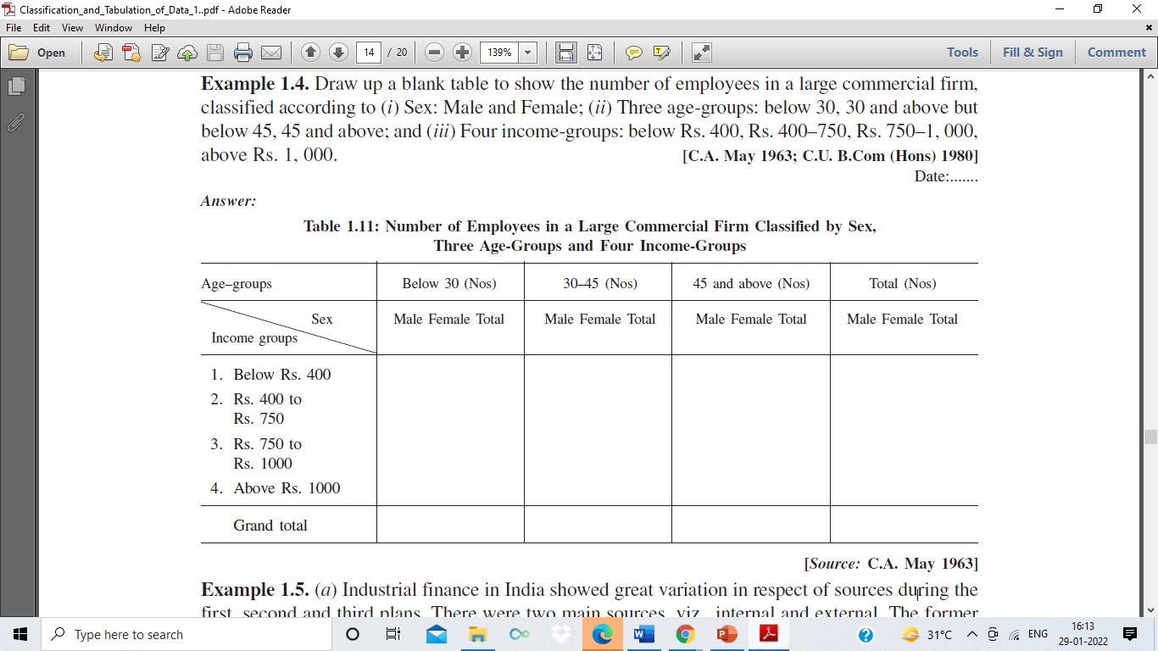
Example
Draw up a blank table to show the number of employees in a large commercial firm,classified according to (i) Sex: Male and Female; (ii) Three age-groups: below 30, 30 and above but below 45, 45 and above; and (iii) Four income-groups: below Rs. 400, Rs. 400–750, Rs. 750–1, 000,above Rs. 1, 000.

Slide 55
Graphical Presentation
Graphical Presentation: We look for the overall pattern and for striking deviations from that pattern. Over all pattern usually described by shape, center, and spread of the data. An individual value that falls outside the overall pattern is called an outlier.
Bar diagram and Pie charts are used for categorical variables.
Histogram, stem and leaf and Box-plot are used for numerical variable.

Slide 56
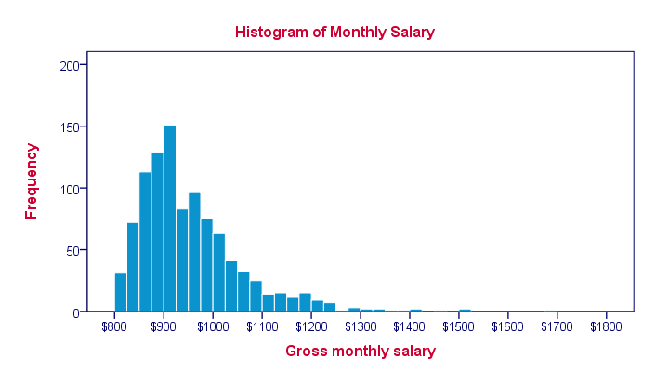
Histogram
A histogram is a graphical display of data using bars of different heights. In a histogram, each bar groups numbers into ranges. Taller bars show that more data falls in that range. A histogram displays the shape and spread of continuous sample data

Slide 57
Box Plotting
Box plots (also called box-and-whisker plots or box-whisker plots) give a good graphical image of the concentration of the data.
They also show how far the extreme values are from most of the data.
A box plot is constructed from five values: the minimum value, the first quartile, the median, the third quartile, and the maximum value.

Slide 58
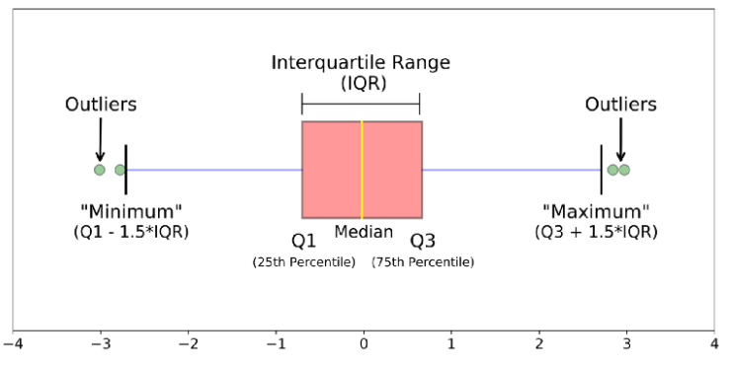
Box Plotting
The image above is a boxplot. A boxplot is a standardized way of displaying the distribution of data based on a five number summary (“minimum”, first quartile (Q1), median, third quartile (Q3), and “maximum”). It can tell you about your outliers and what their values are. It can also tell you if your data is symmetrical, how tightly your data is grouped, and if and how your data is skewed.

Slide 59
Stem and leaf plots
Stem and leaf plots display the shape and spread of a continuous data distribution.
These graphs are similar to histograms, but instead of using bars, they show digits.
It’s a particularly valuable tool during exploratory data analysis. They can help you identify the central tendency, variability, skewness of your distribution, and outliers.
Stem and leaf plots are also known as stemplots.
Each data point is split into a stem and leaf value.
The stem values divide the data points into groups.
The stem value contains all the digits of a data point except the final number, which is the leaf.
For example, if a data point is 42, the stem is 4 and the leaf is 2. When your data have more digits, you’ll need a longer stem. For instance, 238 has a stem of 23 and a leaf of 8.

Slide 60
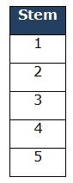
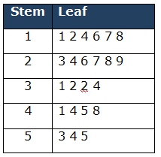
Stem and leaf plots
Example: A teacher asked 23 of her male students how many books they had read in the last 4 years. Draw a stem and left diagram for following data.
32,55,12,18,23,26,24,28,44,53,27,16,14,34,29,31,41,17,11,32,54,48,45
First, Sort the numerical values in ascending order
11,12,14,16,17,18,23,24,26,27,28,29,31,32,32,34,41,44,45,48,53,54,55
Analyze the data and determine stem and a leaf : Minimum value is 11 and maximum value is 55.
Draw a line and lists the possible stems in single column from lowest to highest on the left side of the line.
Then for each stem, record all the leaves associated with that stem. Also note that leaves are in numerical order.

Slide 61
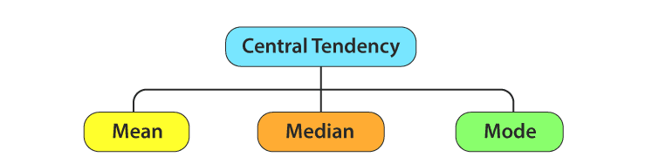
Measures of Centre Tendency
In statistics, the central tendency is the descriptive summary of a data set.
Through the single value from the dataset, it reflects the centre of the data distribution.
Moreover, it does not provide information regarding individual data from the dataset, where it gives a summary of the dataset. Generally, the central tendency of a dataset can be defined using some of the measures in statistics.

Slide 62
Mean
The mean represents the average value of the dataset.
It can be calculated as the sum of all the values in the dataset divided by the number of values. In general, it is considered as the arithmetic mean.
Some other measures of mean used to find the central tendency are as follows:
Geometric Mean (nth root of the product of n numbers)
Harmonic Mean (the reciprocal of the average of the reciprocals)
Weighted Mean (where some values contribute more than others)
It is observed that if all the values in the dataset are the same, then all geometric, arithmetic and harmonic mean values are the same. If there is variability in the data, then the mean value differs.

Slide 63
Arithmetic Mean
Arithmetic mean represents a number that is obtained by dividing the sum of the elements of a set by the number of values in the set. So you can use the layman term Average. If any data set consisting of the values b₁, b₂, b₃, …., b_{n} then the arithmetic mean B is defined as:
B = (Sum of all observations)/ (Total number of observation)
The arithmetic mean of Virat Kohli’s batting scores also called his Batting Average is;
Sum of runs scored/Number of innings = 661/10
The arithmetic mean of his scores in the last 10 innings is 66.1.

Slide 64
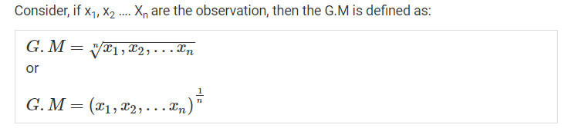
Geometric Mean
The geometric mean is calculated as the N-th root of the product of all values, where N is the number of values.
Geometric Mean = N-root(x1 * x2 * … * xN)
For example, if the data contains only two values, the square root of the product of the two values is the geometric mean. For three values, the cube-root is used, and so on.
So, the geometric mean of our dataset is:
1 * 3 * 9 * 27 * 81 * 243 * 729 = 10,460,353,203
7th root of 10,460,353,203 = 27
geometric mean = 27
The geometric mean is appropriate when the data contains values with different units of measure, e.g. some measure are height, some are dollars, some are miles, etc.

Slide 65
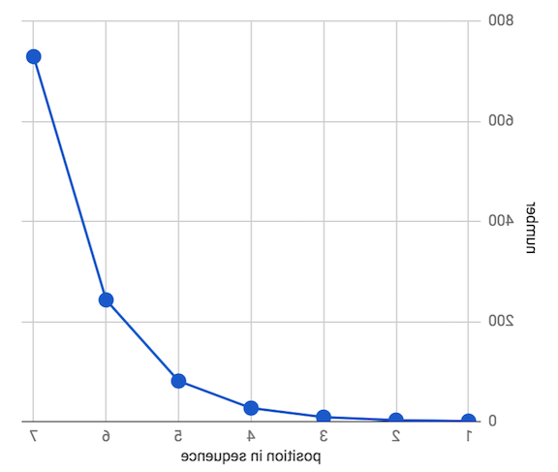
Average, Geometric & Harmonic Means in Data Analysis
1, 3, 9, 27, 81, 243, 729
1 + 3 + 9 + 27 + 81 + 243 + 729 ÷ 7 = 156.1
156 isn’t particularly close to most of the numbers to the dataset. In fact it’s more than 5x the median (middle number), which is 27.
So what to do?
So, the geometric mean of our dataset is:
1 * 3 * 9 * 27 * 81 * 243 * 729 = 10,460,353,203
7th root of 10,460,353,203 = 27
geometric mean = 27

Slide 66
Example
For instance, we want to compare online ratings for two coffeeshops using two different sources. The problem is that source 1 uses a 5-star scale & source 2 uses a 100-point scale:
Coffeeshop A
source 1 rating: 4.5
source 2 rating: 68
Coffeeshop B
source 1 rating: 3
source 2 rating: 75
If we were a bit more number-savvy, we’d know that we have to normalize our values onto the same scale before averaging them with the arithmetic mean, to get an accurate result.
So we multiply the source 1 ratings by 20 to bring them from a 5-star scale to the 100-point scale of source 2:
Coffeeshop A
4.5 * 20 = 90
(90 + 68) ÷ 2 = 79
Coffeeshop B
3 * 20 = 60
(60 + 75) ÷ 2 = 67.5
So we find that Coffeeshop A is the true winner
contrary to the naive application of arithmetic mean above.
If we naively take the arithmetic mean of raw ratings for each coffeeshop:
Coffeeshop A = (4.5 + 68) ÷ 2 = 36.25
Coffeeshop B = (3 + 75) ÷ 2 = 39
We’d conclude that Coffeeshop B was the winner.
The geometric mean, however, allows us to reach the same conclusion without having to fuss over the scale or units of measure:
Coffeeshop A = square root of (4.5 * 68) = 17.5
Coffeeshop B = square root of (3 * 75) = 15
We’d conclude that Coffeeshop A was the winner.

Slide 67
Harmonic Mean
The harmonic mean is calculated as the number of values N divided by the sum of the reciprocal of the values (1 over each value).
Harmonic Mean = N / (1/x1 + 1/x2 + … + 1/xN)
If there are just two values (x1 and x2), a simplified calculation of the harmonic mean can be calculated as:
Harmonic Mean = (2 * x1 * x2) / (x1 + x2)
Those involving rates and ratios, the harmonic mean gives the most correct value of the mean.
e.g. speed, acceleration, frequency, etc.
For example,
if a vehicle travels a specified distance at speed x (eg 60 km / h) and then travels again at the speed y (e.g.40 km / h),
The average speed value is the harmonic mean x, y is :
48 km / h.

Slide 68
How to Choose the Correct Mean?
There are three different ways of calculating the average or mean of a variable or dataset.
The arithmetic mean is the most commonly used mean, although it may not be appropriate in some cases.
Each mean is appropriate for different types of data
If values have the same units: Use the arithmetic mean.
If values have differing units: Use the geometric mean.
If values are rates: Use the harmonic mean.

Slide 69

Mean for grouped data
Masses | 40-49 | 50-59 | 60-69 | 70-79 | 80-89 | 90-99
Frequency | 6 | 8 | 12 | 14 | 7 | 3
CI | f | m | fm
40-49 | 6 | 44.5 | 267
50-59 | 8 | 54.5 | 436
60-69 | 12 | 64.5 | 774
70-79 | 14 | 74.5 | 1043
80-89 | 7 | 84.5 | 591.5
90-99 | 3 | 94.5 | 283.5
Total | 50 |  | 3395

Slide 70
Median

Slide 71
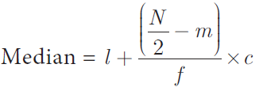
Median
Masses | 40-49 | 50-59 | 60-69 | 70-79 | 80-89 | 90-99
Frequency | 6 | 8 | 12 | 14 | 7 | 3
CI | f | cf
40-49 | 6 | 6
50-59 | 8 | 14
60-69 | 12 | 26
70-79 | 14 | 40
80-89 | 7 | 47
90-99 | 3 | 50
Total | 50
Median class = (N/2)^{th} value
= (50/2)^{th} value
= 25th value
Median class = 60 - 69
l = 60, N//2 = 25, m = 14, f = 12 and c = 10
Substitute
Median = 60 + ([25 - 14]/12) x 10
= 60 + (11/12) x 10
= 60 + 9.1
= 69.1
≈ 69
Where l = Lower limit of the median class,
f = Frequency of the median class
c = Width of the median class,
N = The total frequency (∑f)
m = cumulative frequency of the class preceeding the median class

Slide 72
Median
Score | 41-45 | 36-40 | 31-35 | 26-30 | 21-25 | 16-20
Frequency | 1 | 8 | 8 | 14 | 7 | 2
Where l = Lower limit of the median class,
f = Frequency of the median class
c = Width of the median class,
N = The total frequency (∑f)
m = cumulative frequency of the class preceeding the median class

Slide 73
Median
Score | 41-45 | 36-40 | 31-35 | 26-30 | 21-25 | 16-20
Frequency | 1 | 8 | 8 | 14 | 7 | 2
<cf | 40 | 39 | 31 | 23 | 9 | 2
Where l = Lower limit of the median class,
f = Frequency of the median class
c = Width of the median class,
N = The total frequency (∑f)
m = cumulative frequency of the class preceeding the median class

Slide 74
Median
Score | 41-45 | 36-40 | 31-35 | 26-30 | 21-25 | 16-20
Frequency | 1 | 8 | 8 | 14 | 7 | 2
<cf | 40 | 39 | 31 | 23 | 9 | 2
Where l = Lower limit of the median class,
f = Frequency of the median class
c = Width of the median class,
N = The total frequency (∑f)
m = cumulative frequency of the class preceeding the median class
Median class = (N/2)^{th} value
= (40/2)^{th} value
= 20th value
Median class = 26- - 30
l = 26, N//2 = 20, m = 9, f = 14 and
c = 5
Substitute
Median = 26 + ([20 - 9]/14) x 5
= 26 + (11/14) x 5
= 26+3.92
= 29.92
≈ 30

Slide 75

Mode
Score | 41-45 | 36-40 | 31-35 | 26-30 | 21-25 | 16-20
Frequency | 1 | 8 | 8 | 14 | 7 | 2

Slide 76

HW

Slide 77
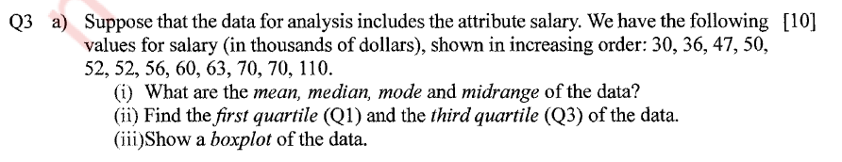
Box Plot

Slide 78
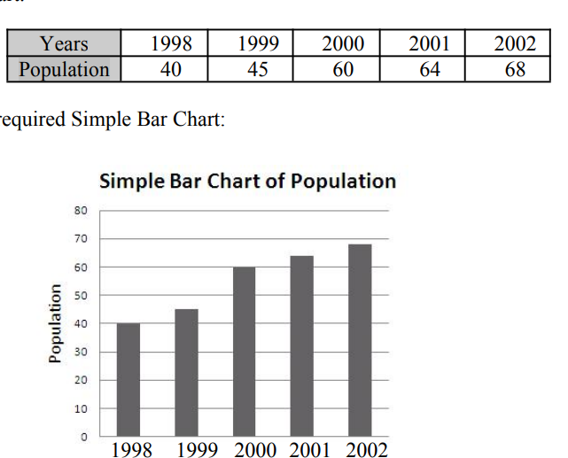

Slide 79
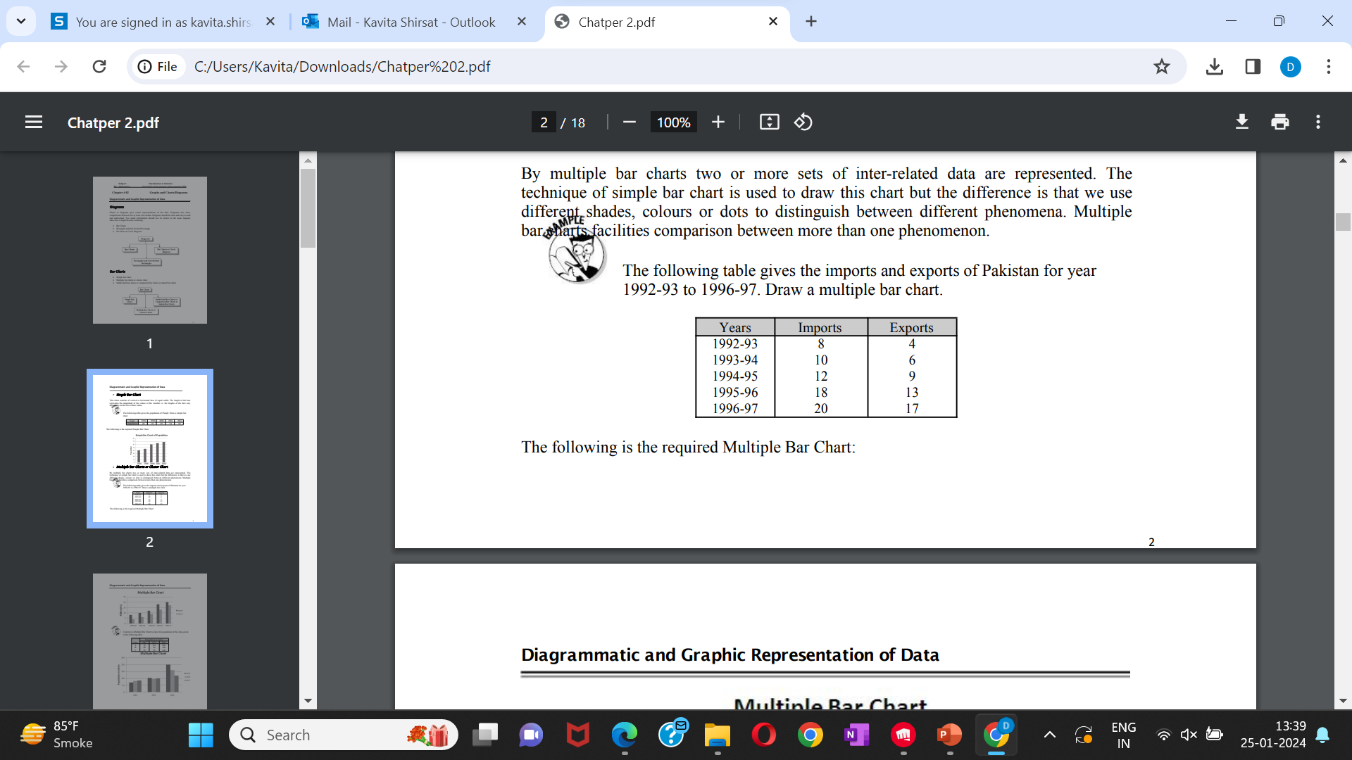
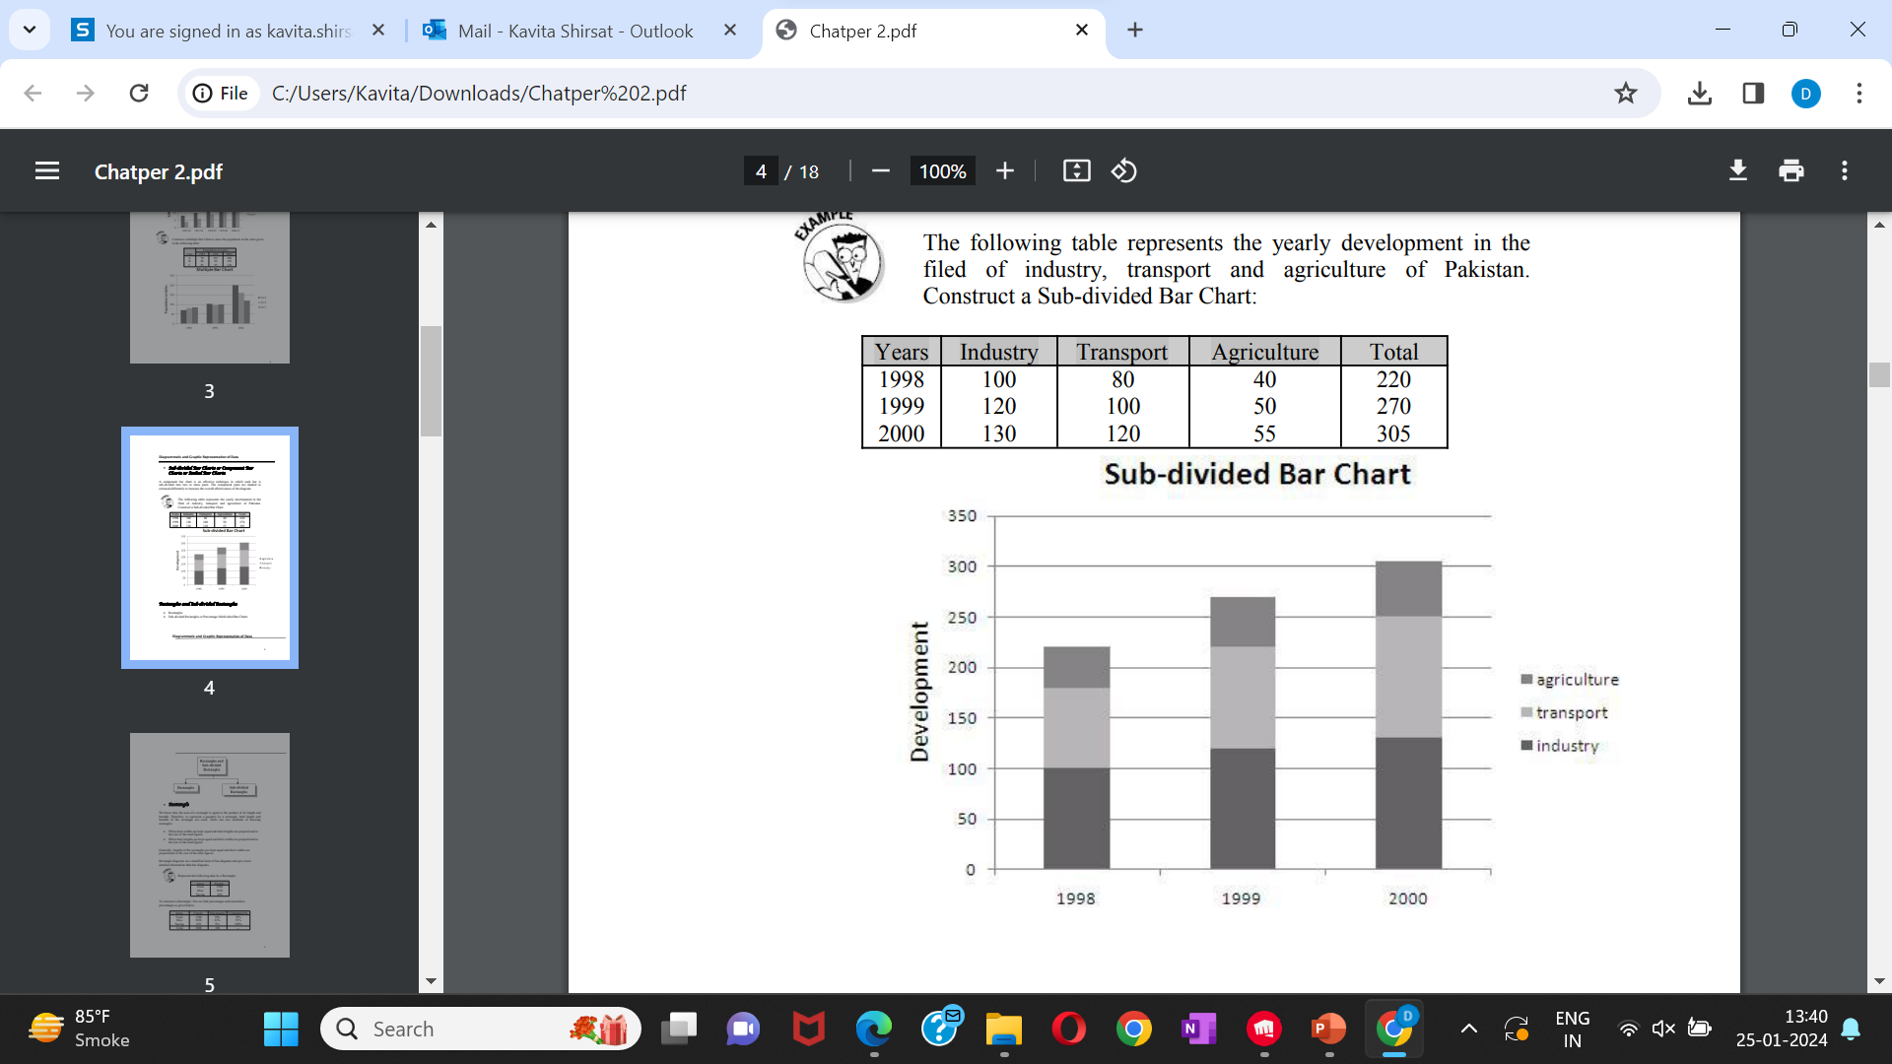
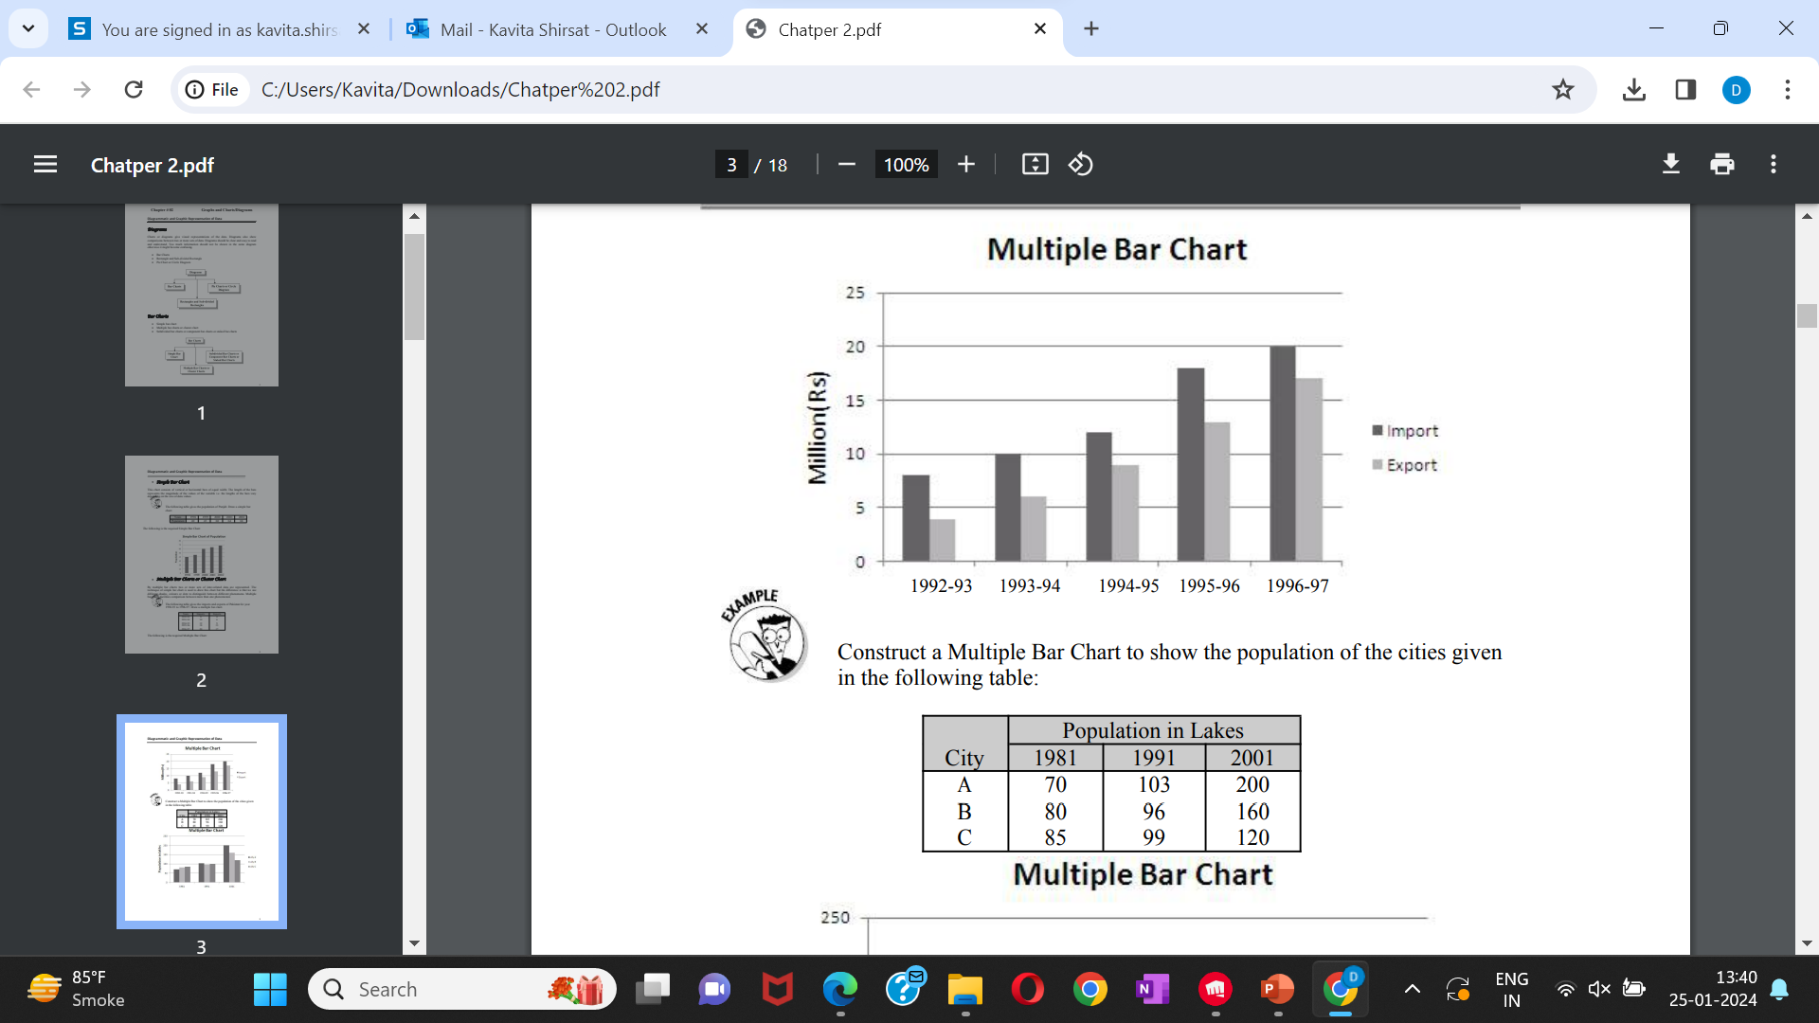

Slide 80
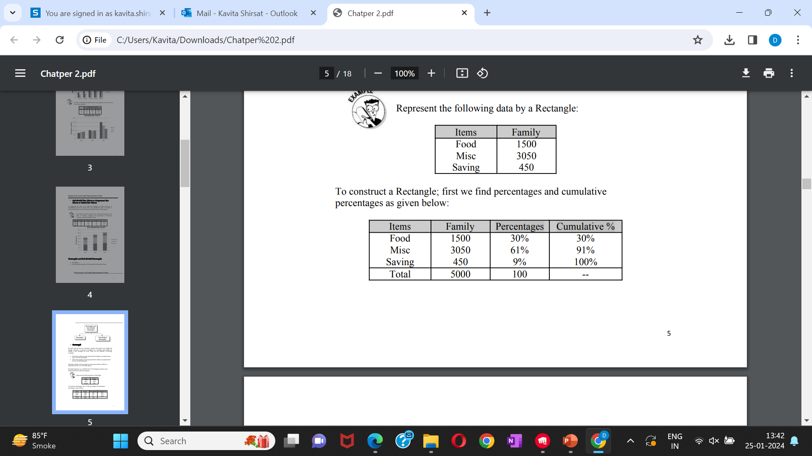
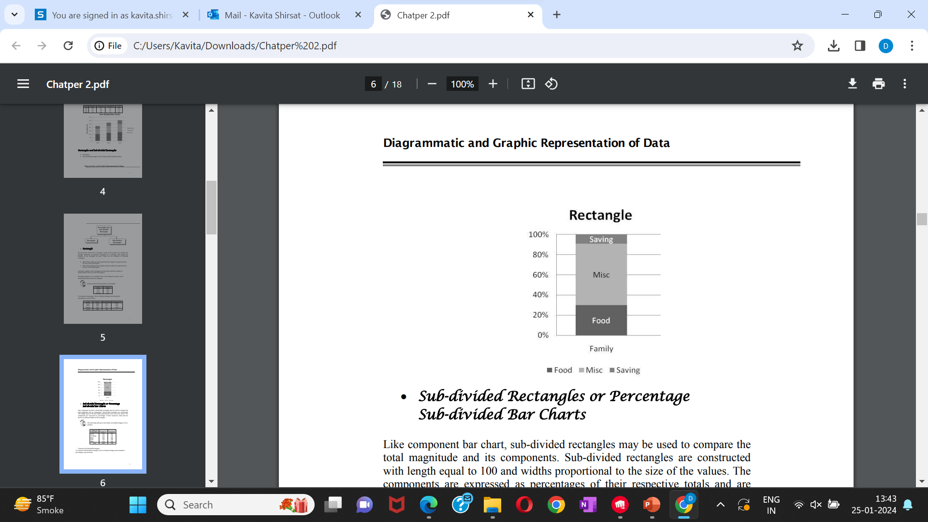
Represent the following data by a Rectangle:
To construct a Rectangle; first we find percentages and cumulative percentages as given below:

Slide 81
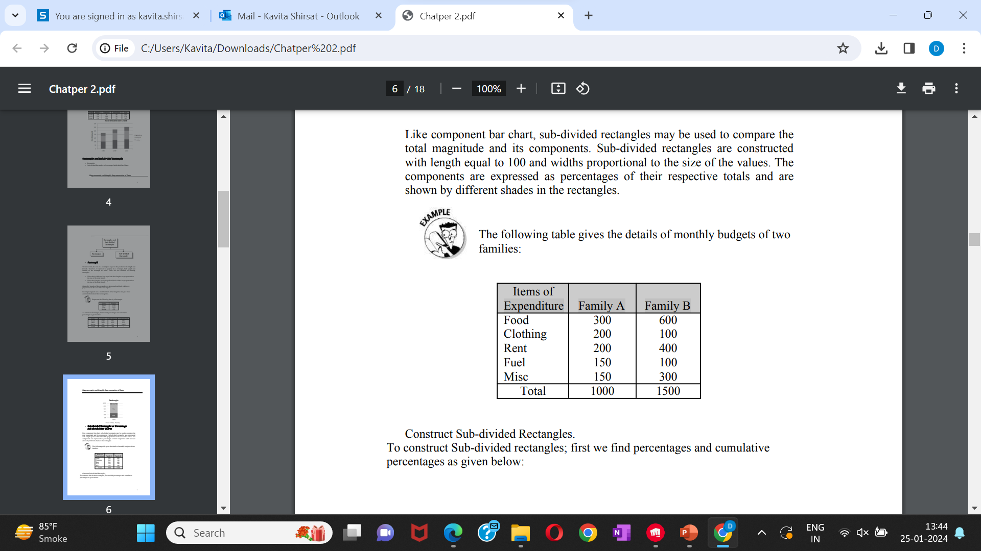
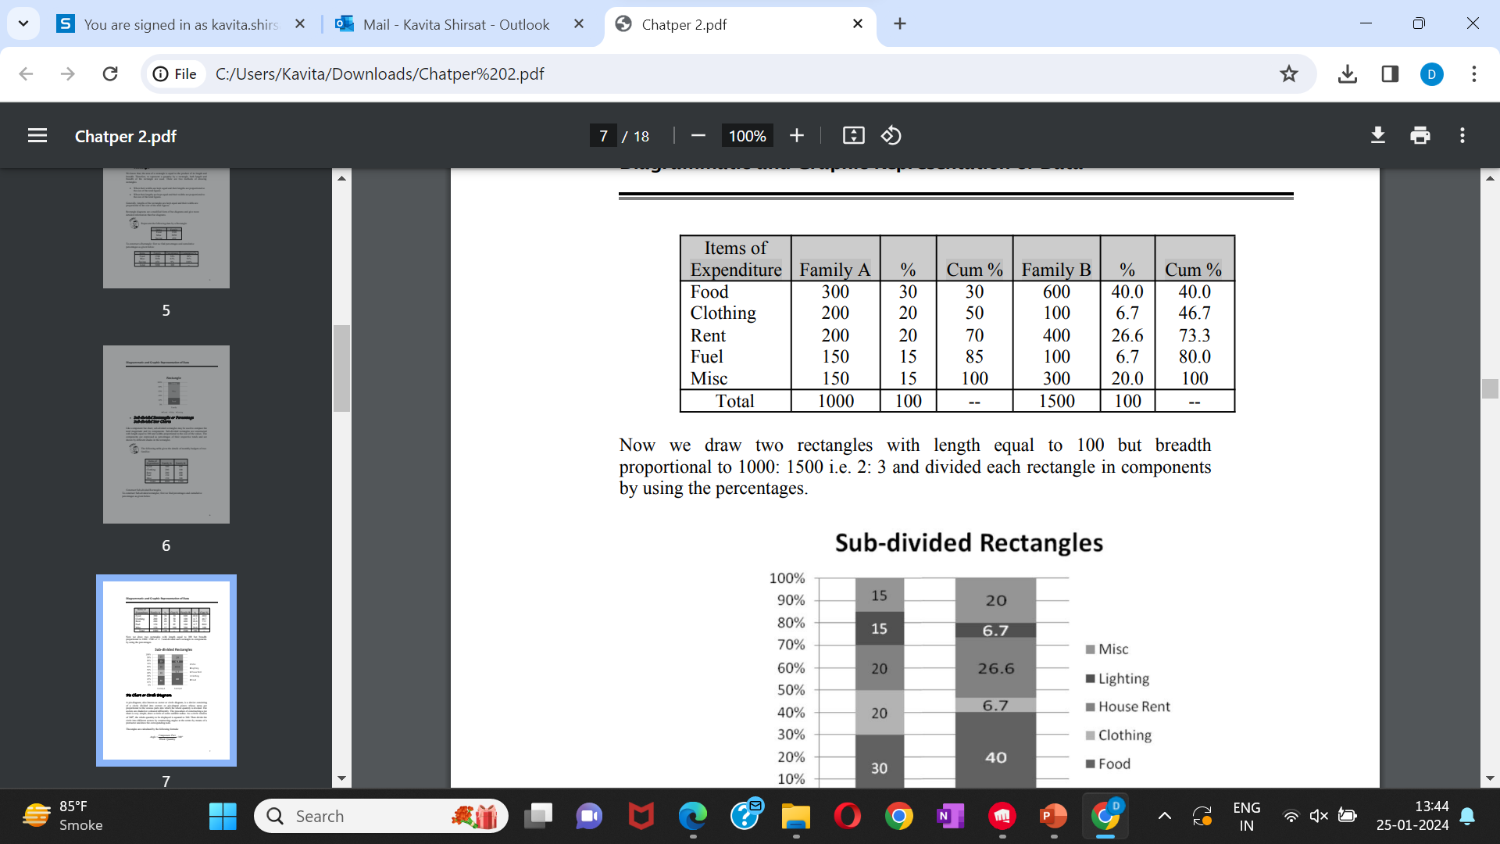
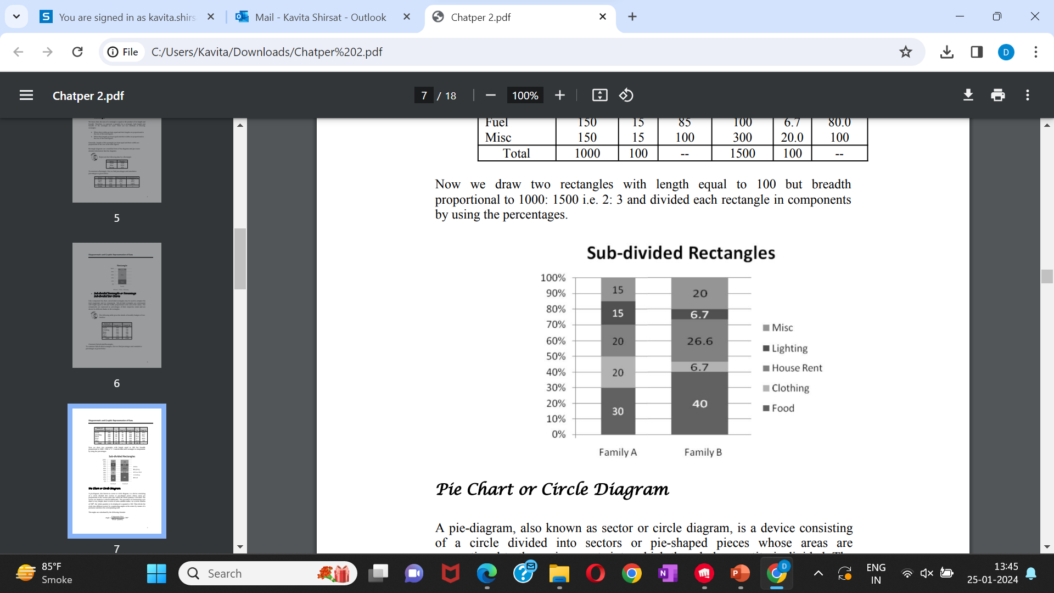
Sub-divided Rectangles.
The following table gives the details of monthly budgets of two families:

Slide 82
Primary Data Vs Secondary Data
Primary Data
Primary data is the data that is collected for the first time through personal experiences or evidence, particularly for research.
It is also described as raw data or first-hand information.
The mode of assembling the information is costly.
The data is mostly collected through observations, physical testing, mailed questionnaires, surveys, personal interviews, telephonic interviews, case studies, and focus groups, etc.

Slide 83
Primary Data Vs Secondary Data
Secondary Data
Secondary data is a second-hand data that is already collected and recorded by some researchers for their purpose, and not for the current research problem.
It is accessible in the form of data collected from different sources such as government publications, censuses, internal records of the organisation, books, journal articles, websites and reports, etc.
This method of gathering data is affordable, readily available, and saves cost and time.
However, the one disadvantage is that the information assembled is for some other purpose and may not meet the present research purpose or may not be accurate.

Slide 84



Career and Job Opportunities
It’s not enough to have an MBA degree from a top-notch B-School.
Quantitative analyst is the rocket scientist of the finance world.
quantitative analysts apply a blend of techniques and knowledge
from multiple disciplines including
Finance, Economics, mathematics, statistics
and computer science.
Quant Analyst earn an average of ₹17lakhs, mostly ranging from ₹14lakhs per year to ₹23lakhs per year
There is a high demand for quantitative analysts, but very low supply
Can a quantitative analyst become a data scientist?
The answer to this is YES.
Certification:

Slide 85


